Slide 1
Project presentation
Presenting work done by:
Yaron Orenstein*, Eran Mick*, Ron Shamir
Improved motif finding in PBM data
ACGT group meeting 04/01/12

Slide 2
Talk layout
Introduction
Reminder of PBM data and the problem.
Summary of what was done so far.
Previous work
Reminder of Seed-and-Wobble and RankMotif++.
New method: BEEML-PBM.
Current work
Description of our new algorithm.
Comparison to previous algorithms.

Slide 3
Gene expression regulation
Transcription is regulated mainly by transcription factors (TFs) - proteins that bind to DNA subsequences, called binding sites (BSs).
TFBSs are located mainly in the gene’s promoter – the DNA sequence upstream the gene’s transcription start site (TSS).
TFs can promote or repress transcription
Other regulators: micro-RNAs (miRNAs).

Slide 4
TFBS models
We represent the binding site as a position weight matrix (PWM). Each position has weights for the 4 possible letters (A, C, G, T).
For example:
6 | 5 | 4 | 3 | 2 | 1
0 | 0.2 | 0.7 | 0 | 0.8 | 0.1 | A
0.6 | 0.4 | 0.1 | 0.5 | 0.1 | 0 | C
0.1 | 0.4 | 0.1 | 0.5 | 0 | 0 | G
0.3 | 0 | 0.1 | 0 | 0.1 | 0.9 | T

Slide 5
PBM technology
Protein binding microarray consists of ~41,000 probe sequences, each of length 36 bp.
These 36 bp long sequences cover all possible 10-mers.
They were generated by cutting a long De Bruijn sequence (with overlaps).
Wiki: a k-ary De Bruijn sequence B(k, n) of order n is a cyclic sequence of a given alphabet A with size k for which every possible subsequence of length n in A appears as a sequence of consecutive characters exactly once.
Each B(k, n) has length k^{n}.
Example of B(2, 3): 00010111 and 11101000.

Slide 6
PBM in illustration

Slide 7
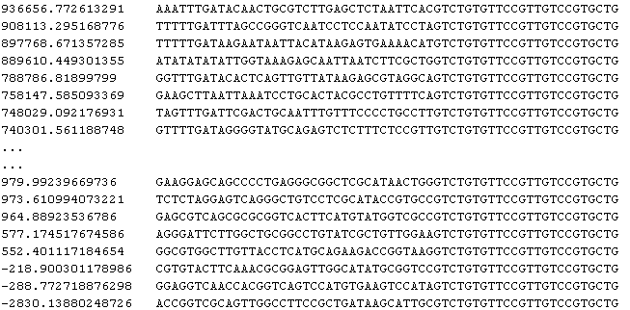
And this is how it looks like: example dataset of Arid3a

Slide 8
The data we worked on
UniProbe (Newburger and Bulyk. 2008) database contains more than 400 PBM datasets, each for a different TF.
We focused on one subset of this data set (Badis et al. 2009), which covers 104 different mouse TFs in 115 paried PBM datasets.
For each probe sequence, the binding intensity is reported.

Slide 9
Seed-and-Wobble (SW)
The first method to extract binding site motifs from PBM data is Seed-and-Wobble (Berger et al. 2006).
It first identifies the single 8-mer (ungapped or gapped) with the greatest PBM enrichment score (E score) and then systematically tests the relative preference of each nucleotide variant at each position, both within and outside the seed.

Slide 10
RankMotif++ (RM) (Chen et al. 2007)
RankMotif++ learns motif models by maximizing the likelihood of a set of binding preferences under a probabilistic model of how sequence binding affinity translates into binding preference observations.
It learns the ranking of the probes using a PWM model for the BS and scoring k-mers of each probe according to the PWM.

Slide 11
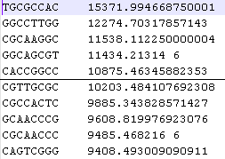
Amadeus-PBM (AM)
Rank all k-mers according to some score.
Give the top ranking k-mers to a motif finding algorithm.
We give the 1000 top ranked 9-mers (according to average binding intesnity) to Amadeus.
Target set

Slide 12
Example: Cebpb

Slide 13
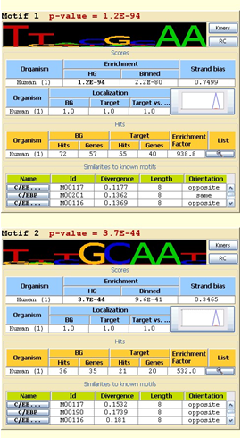
And the result of Amadeus:

Slide 14
New method: BEEML-PBM
Developed by Zhao and Stormo (Nat. Biotech., June 2011), an extension to BEEML.
Algorithm:
Estimate the position and background effects from the data.
Perform weighted regression to assign parameters to a model of binding energy, explicitly taking these biases into account.

Slide 15
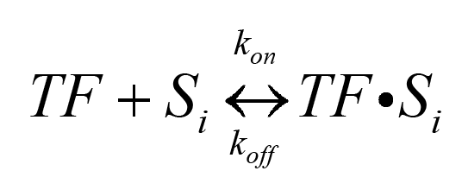
Calculation of binding probability
The reaction in a PBM experiment:
S_{i} = DNA binding sequence
K_{on} = rate of formation of the complex
K_{off} = dissociation rate
K_{d} = K_{on}/K_{off}

Slide 16
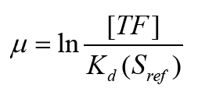
Binding probability – cont’d
At equilibrium, the binding probability is:
E_{i} is the difference in free energy between binding to S_{i} and the reference sequence
μ is the log ratio of free TF concentration and Kd of the reference sequence:

Slide 17
Calculation of binding probability
For a l-long PWM, with ε(b,k) representing the energy contribution from base b at position k of binding site, the binding energy of S_{i} is:
S_{i}(b,k) is an indicator variable with S_{i}(b,k)=1 if base b occurs at position k of S_{i}.

Slide 18
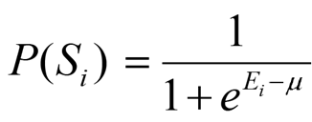
Binding probability – cont’d
At equilibrium, the binding probability is:
μ is the log ratio of free TF concentration and K_{d} of the reference sequence:

Slide 19
Binding probability – cont’d
Binding probability to a position j of the probe, with sequence S_{i} is:
TF cannot bind to both strands at the same position of the probe at the same time.
Ignore overlapping binding sites due to very low probability.

Slide 20
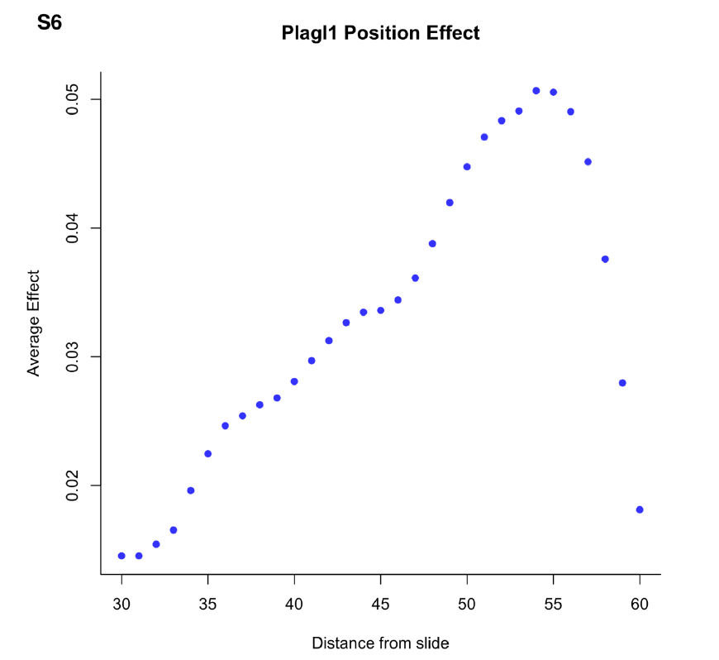
Estimation of position effect
Closer to the center, increased binding
Estimation done empirically using top 25 8–mers with highest median intensities.

Slide 21
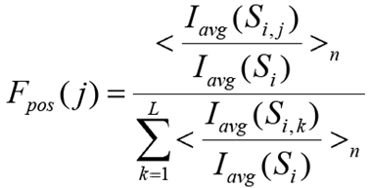
Position effect – cont’d
The effect of position j:
L = length of variable region on the probe.
I_{avg}(S_{i},k) = average intensity of probes at pos k.
I_{avg}(S_{i}) = average intensity of all probes.
<S_{i}>_{n} = average over top n k-mers.

Slide 22
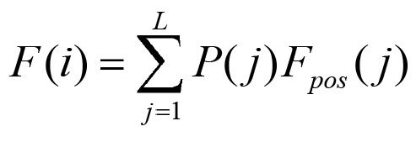
Position effect – cont’d
Binding probability of the probe i is:
L = length of the randomized region on probe.

Slide 23
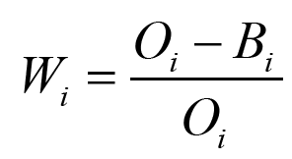
Background effect estimation
Intensity of most probes is due to microarray background rather than TF binding.
Probe intensities are binned (200 bins).
Probability that probe intensities in bin i is generated by TF binding is:
O_{i} = the observed number of probe in bin i
B_{i} = expected number of probes in bin i from background distribution

Slide 24
Objective function
Minimze (by Levenberg-Matquardt algorithm) the objective function:
Y_{i} = z-transformed probe intensity
F_{i} = binding probability to the probe
ε = PWM energy model
a, c = used to scale model predicted probe occupancy to fluorescence units
λ = penalization parameter (0.01) to avoid overfitting

Slide 25
Summary of BEEML concept
Takes into account:
Position effect.
Background effect.
Physical binding model.
Outputs model that best predicts the binding intensities.

Slide 26
Results – PWM similarity
Used Euclidean distance to compared with:
JASPAR (Portales-Casamar, 2010)
TRANSFAC (Matys et al., 2003)
ScerTF (Spivak and Stormo, 2012)
Amadeus is closest, after SW, RM and BE (JASPAR): 0.178, 0.193, 0.21, 0.227
The information content is also in that order: 1.23, 1.2, 0.9 and 0.72 bits

Slide 27
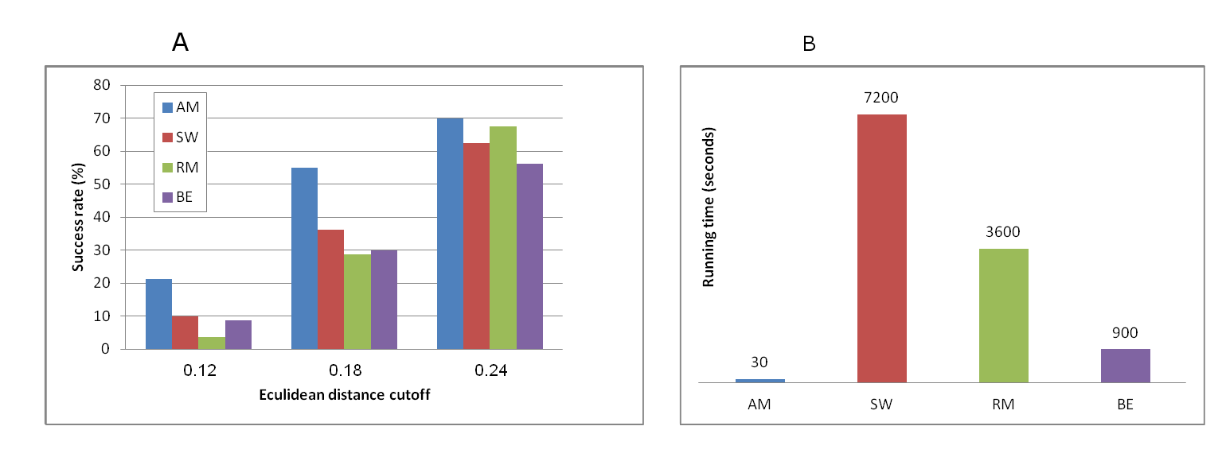
Success rate and running time
Success rate = rate of PWMs under the threshold.
Average running time in seconds.

Slide 28
Results – PWM logos
Amadeus PWMs are most distinct and easily interpretable.

Slide 29
Ranking prediction test
Tested on positive sets of 200 top probes.
Spearman rank coefficient:
Sensitivity (at 1% FP):
#TP / (#TP + #FN)
3. AUC of ROC.

Slide 30
Results – prediction ability
BE is best, followed by AM, RM and SW (in that order).
BE has significantly better performance as positive probe set size increases.

Slide 31
Results - conclusions
These results lead us to the conclusion that there is a trade-off between interpretability and prediction ability.
Interpretability
&
similarity to PWMs
AM
?
SW
Can we have an alg. that is best in both?
Or is there an inherent trade-off in the PWM model?
RM
BE
Ranking prediction

Slide 32
March 2011
CS Workshop
TAU
Finding sequence motifs in PBM data
Eran Mick
David Glauber

Slide 33
Ranking
Deduce overly represented 8-mers in high ranking probes
PWM
Formulate fixed-length PWM, weighting 8-mer contributions by square of rank
Bounding
Bound motif by position significance
Alignment
Align top 100 8-mers
Overview

Slide 34
B – Size of background set F – Size of foreground set
ρ_{B} – Sum of background ranks ρ_{F} – Sum of foreground ranks
10
00
01
01
00
01
01
01
TGCGACGAGAGGACCCGGTTTGAAGAGAACTAAGCG
ACTCTATTGTCTTTCTTAAAGTTAATTAATATTGAT
AGACCTAACCACACATTGCTAATTAGCACATAAATT
35349
...
...
0
1
2
35,349
4⁸-2
4⁸-1
...
^{st}1
^{nd}2
^{rd}3
^{th}4
^{th}5
Ranking

Slide 35
TAATGCGA
-------
ATAATGCG
----------
x8
AATGCGAC
GATAATGC
TAATGTGC
AATGCGCC
TAATGTAC
ATGTAACC
Star Alignment
Notes:
Main challenge encountered: palindromes.

Slide 36
TAATGCGA
ATAATGCG
Weight
AATGCGAC
GATAATGC
TAATGTGC
AATGCGCC
TAATGTAC
ATGTAACC
PWM formulation

Slide 37
 |  |  | 0.95
 |  | 0.95
 |  |  |  | 0.9
 |  |  |  |  | 0.85
Decreasing signal strength – decreasing number of 8-mers
PWM formulation

Slide 38
Core+2
Core+1
Core
0.42 | 0.0873 | 0.021
0.144 | 0.42 | 0.968
0.336 | 0.4 | 0.0015
0.091 | 0.0879 | 0.0081
0.613 | 0.028 | 0.02
0.025 | 0.551 | 0.969
0.347 | 0.409 | 0.003
0.0127 | 0.01 | 0.006
0.496 | 0.009 | 0
0.084 | 0.609 | 1
0.372 | 0.337 | 0
0.043 | 0.04 | 0
0.576 | 0.018 | 0.012
0.047 | 0.61 | 0.98
0.35 | 0.326 | 0.0009
0.023 | 0.041 | 0.0048
0.625 | 0 | 0
0.023 | 0.732 | 1
0.341 | 0.253 | 0
0.009 | 0.016 | 0
Example

Slide 39
,
A
P_{1A}
P_{2A}
P_{3A}
P_{4A}
P_{5A}
P_{6A}
P_{7A}
P_{8A}
P_{9A}
P_{10A}
P_{11A}
P_{12A}
P_{13A}
P_{14A}
C
P_{1C}
P_{2C}
P_{3C}
P_{4C}
P_{5C}
P_{6C}
P_{7C}
P_{8C}
P_{9C}
P_{10C}
P_{11C}
P_{12C}
P_{13C}
P_{14C}
G
P_{1G}
P_{2G}
P_{3G}
P_{4G}
P_{5G}
P_{6G}
P_{7G}
P_{8G}
P_{9G}
P_{10G}
P_{11G}
P_{12G}
P_{13G}
P_{14G}
T
P_{1T}
P_{2T}
P_{3T}
P_{4T}
P_{5T}
P_{6T}
P_{7T}
P_{8T}
P_{9T}
P_{10T}
P_{11T}
P_{12T}
P_{13T}
P_{14T}
Bounding

Slide 40
Results
Best results achieved when:
No differentiation between cores.
1000 k-mers used.
All 14 positions are reported.
Prediction ability on a par with BEEML-PBM:
Spearman 0.23 vs. 0.21 (avg.)
Tp1FP 0.48 vs. 0.47 (avg.)
AUC 0.89 vs. 0.88 (avg.)
JASPAR similarity on a par with Amadeus: 0.174, AM 0.178 SW 0.192 RM 0.21 BE 0.227

Slide 41
New comparison
Harbison et al. (04) used Chip-Chip to annotate bound and unbound promoters.
PWM used to rank promoters.
For each cutoff, Fisher exact test is calculated, and the minimal is chosen.
The new method has better PWMs than BE in this comparison.
Used in ScerTF paper (Spivak and Stormo 2012).

Slide 42
Additional advantage
Running time: 2 seconds!
AM is 30 seconds.
BE, RM, AM more than one hour.

Slide 43
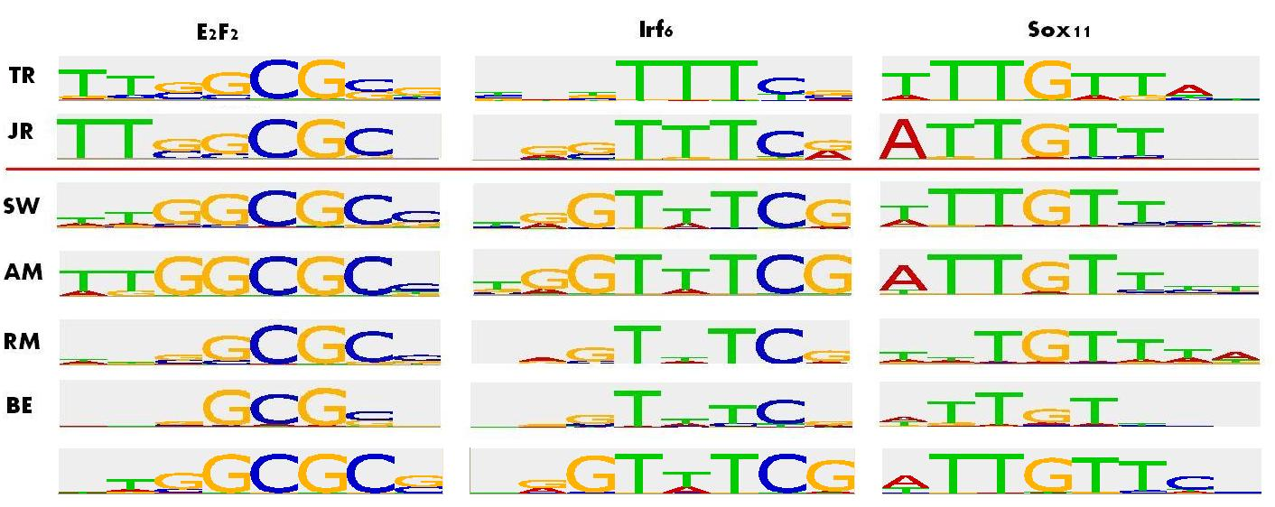
Logos example
Using ScerTF database, average Euclidean: 0.186
AM 0.181 SW 0.184 RM 0.24 BE 0.247

Slide 44
Summary
We have developed a new method for extracting binding site motif from PBM data.
It ranks all 8-mers using WMW score.
It builds a PWM using 8-mer weights.

Slide 45
Summary –cont’d
The method achieves prediction ability and similarity to experimentally validated PWMs as good as BE and AM, respectively.
It achieves better in vivo prediction, as proved on Harbison et al. dataset.
In addition, it is ultra-fast (2 seconds!).

Slide 46
Conclusions
BEEML-PWM is over-tuned to PBM technology.
Our method takes PBM data and extracts a PWM that is most accurate for specific in vivo and in vitro binding.

